Slide 1
Traffic Safety: City of Chicago
Erika Haren
Will Skrab
Caitlin Hemler
Robert Wood

Slide 2
Project Description
Study of the relationship between different types of law enforcement traffic cameras and crashes, using data made publicly available by the City of Chicago.

Slide 3
Data Sources
Red Light Camera Locations (data.cityofchicago.org)
Red Light Camera Violations (data.cityofchicago.org)
Speed Camera Locations (data.cityofchicago.org)
Speed Camera Violations (data.cityofchicago.org)
Traffic Crashes (data.cityofchicago.org)

Slide 4
Questions considered
Do red light cameras prevent crashes?
Do speed cameras prevent crashes?
Is there a correlation between red light cameras and number of violations?
Is there a correlation between speed cameras and number of violations?

Slide 5
Chicago Data
Population = 2.716 million as of 2017
Median age is 34.4
Median Income $53,006.00
There are roughly 4.5 million cars in Illinois
Estimated 55 million people visit the city annually

Slide 6
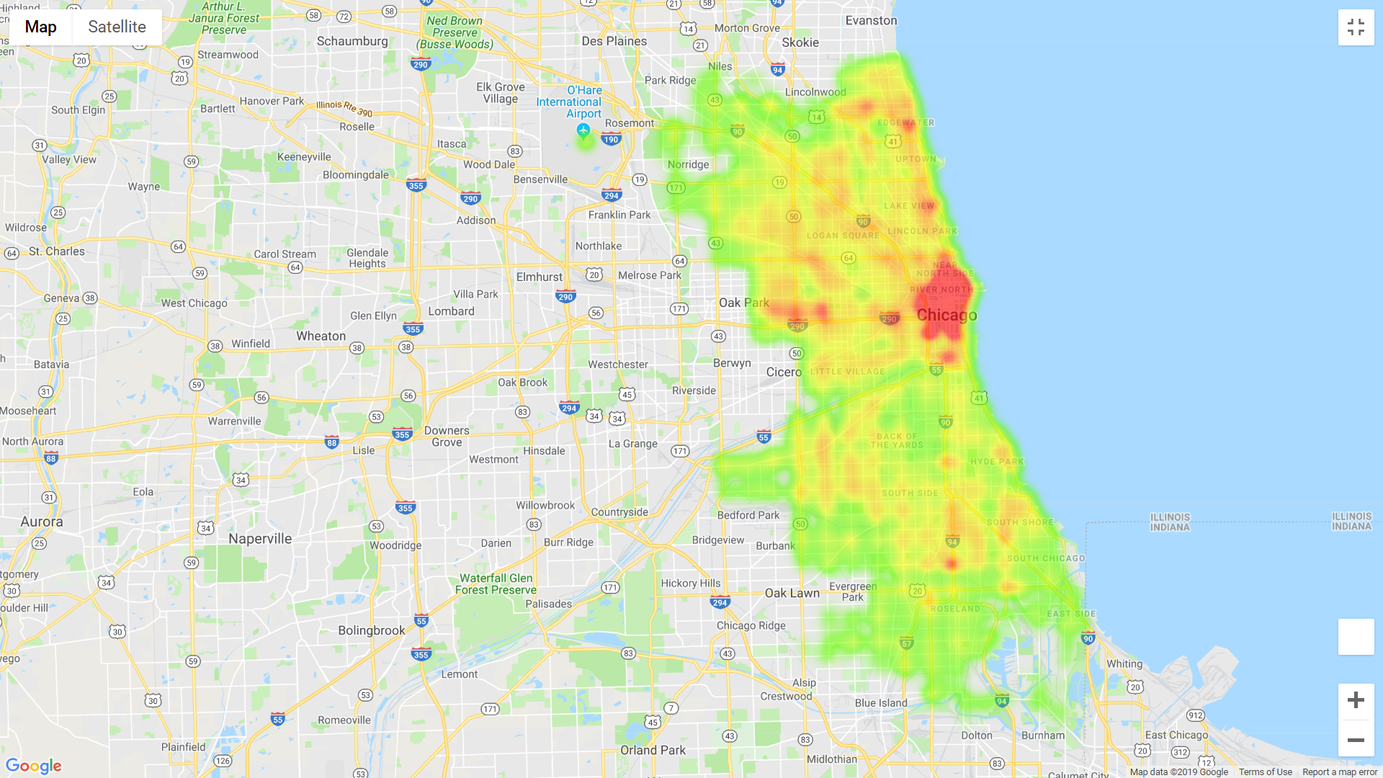
Traffic Crashes
Heatmap of traffic crashes, 2017-present

Slide 7
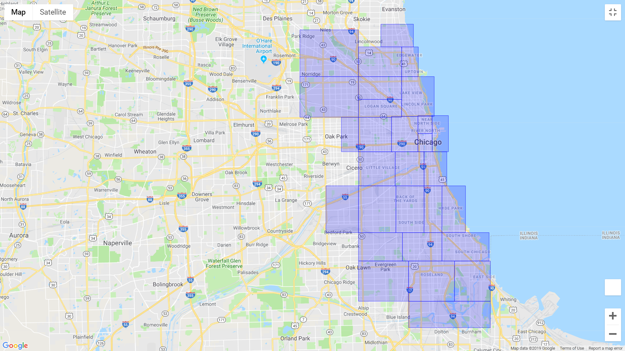
Traffic Regions
1
2
3
4
5
6
8
7
12
29
9
10
11
13
14
15
16
20
21
17
18
19
29 regions, defined by the City of Chicago
22
23
24
25
26
27
28

Slide 8
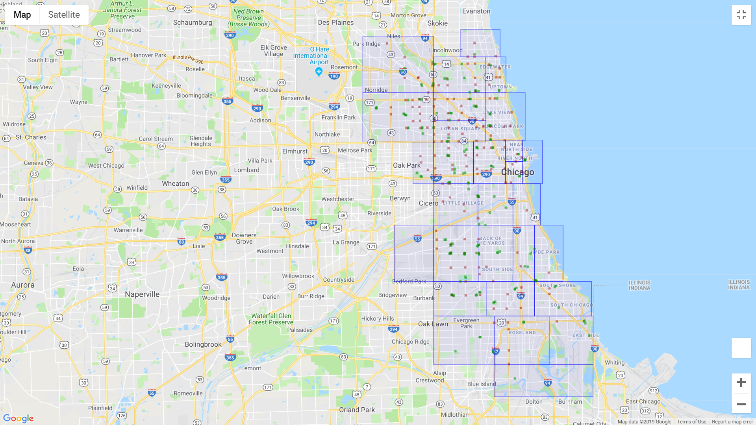
Traffic Regions, Incl. Red Light and Speed Cameras
Red Light Cameras
Speed Cameras
29 regions, defined by the City of Chicago

Slide 9
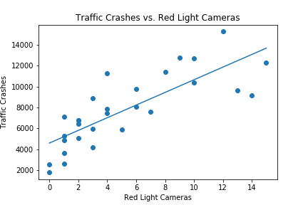
Crashes vs. Red Light Cameras

Slide 10
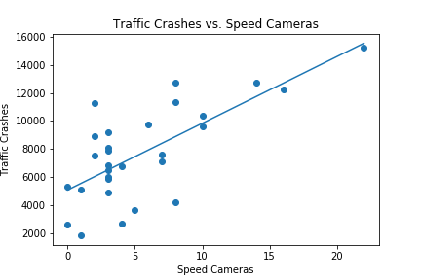
Crashes vs. Speed Cameras

